Slide 1

Exploratory Data Analysis of Unicorn Company
Python for Data Analytics Project 2023 – July DAF
BY: Abdullahi Umar Faruk

Slide 2
Major Highlights
Which unicorn companies have had the biggest return on investment?
How long does it usually take for a company to become a unicorn?
Which countries have the most unicorns?
Are there any cities that appear to be industry hubs?
Which investors have funded the most unicorns?

Slide 3
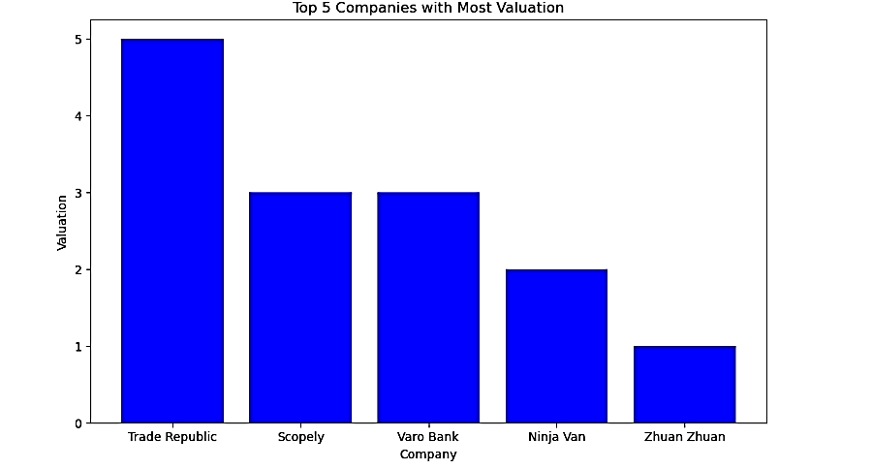
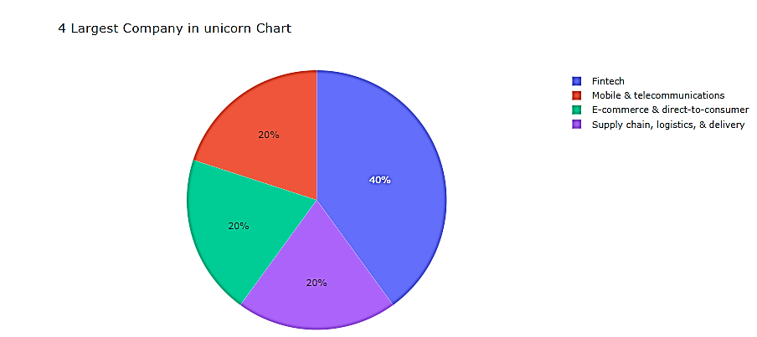
Overview of Unicorn Company Across the World
Observation
40% of the Unicorn startups Industry is Fintech.
Fintech is a Financial technology and innovation that aims to compete with traditional financial methods in the delivery of financial services.
It is an emerging industry that uses technology to improve activities in finance.

Slide 4
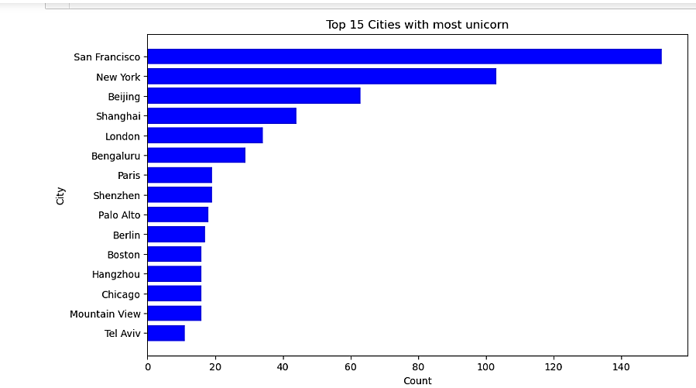
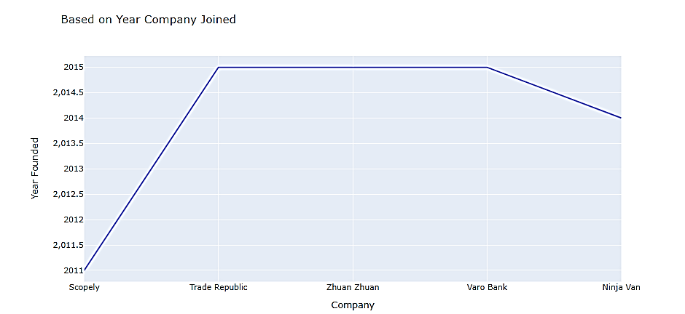
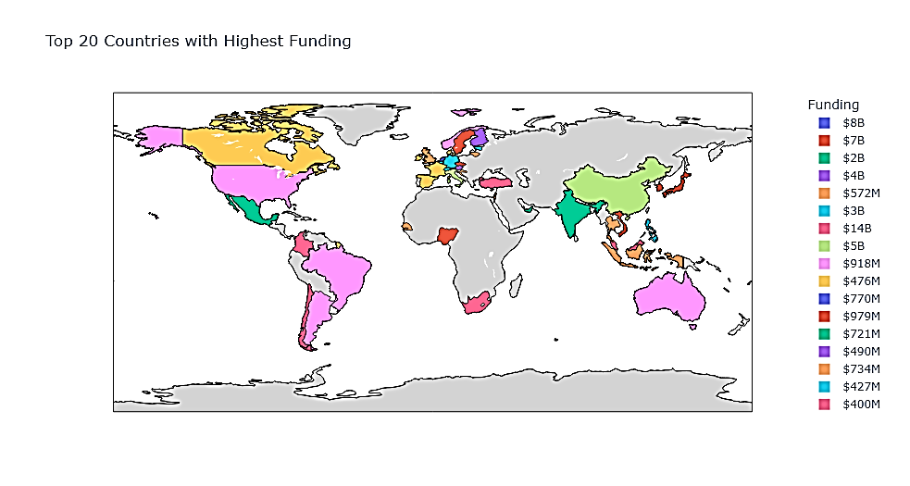
Observation
As expected, San Francisco City has the highest number of Unicorn Startups. Bengaluru City has 25. New York has 81.

Slide 5
RECOMMENDATION Overall recommendations to help Unicorn Companies in creating good business model
Continuously monitor early-stage startups in the portfolio for signs of high growth potential, such as rapid user adoption, revenue growth, and market expansion.
Rationale: Startups can experience exponential growth at various stages of their development. Unicorn Companies should stay vigilant and adapt their investment strategies to support and nurture companies that exhibit strong growth indicators.
Regularly reassessing the portfolio ensures that they capitalize on emerging opportunities. These recommendations are data-driven and aim to help Unicorn Companies make informed decisions to create robust business models, maximize returns, and manage risk effectively.
By focusing on sectors with growth potential, diversifying investments, prioritizing experienced leadership, and actively monitoring startups, Unicorn Companies can enhance their investment strategy and increase their chances of success in the dynamic world of startup investments.

